Slide 1
Big Data – Big Data Fundamentals Week 3
Professor Arturo Castellanos, PhD
Assistant Professor – William & Mary
Big Data - MSBA

Slide 2

Week 2 – Map/Reduce Patterns
Outline
Analytics patterns
Hadoop in Docker (Friday class was on-demand. Any questions?)
Map Reduce patterns
Numerical Summarization
Top-N
Filter
Distinct
Binning
Inverted Index
Sorting
Joins
Regular Expressions
Chapter 8 - © 2019 Arshdeep Bahga & Vijay Madisetti

Slide 3
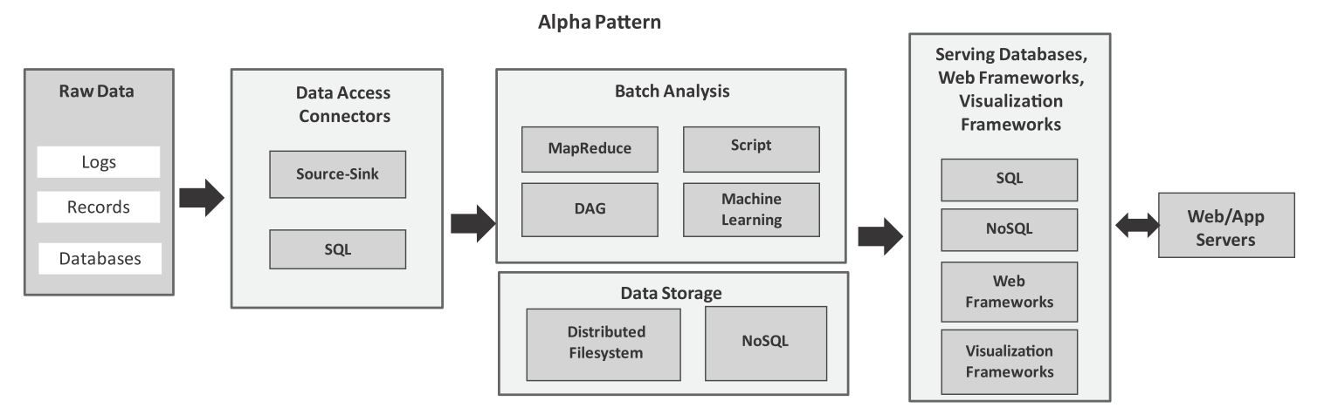
Analytics Patterns: alpha pattern
Alpha pattern
This pattern can be used for ingesting large volumes of data into a distributed ﬁlesystem (such as HDFS) or a NoSQL database (such as HBase) using source-sink connectors (such as Flume) and SQL connectors (such as Sqoop). After the data is moved to the stack, the data can be analyzed in batch mode with batch analysis frameworks including MapReduce (using Hadoop), scripting frameworks (such as Pig), distributed acyclic graph frameworks (such as Spark), machine learning frameworks (such as Spark MLlib). The analysis results are stored either in relational or non-relational databases.
Chapter 8 - © 2019 Arshdeep Bahga & Vijay Madisetti

Slide 4
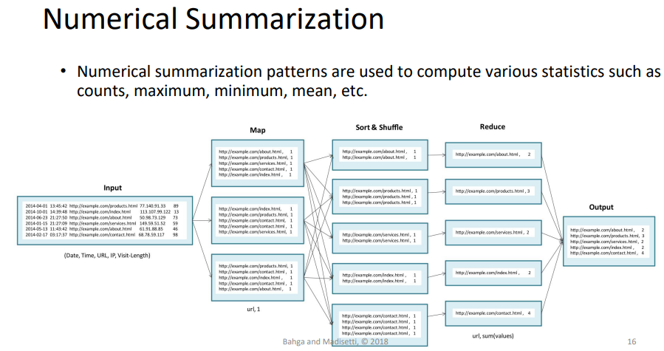

Slide 5
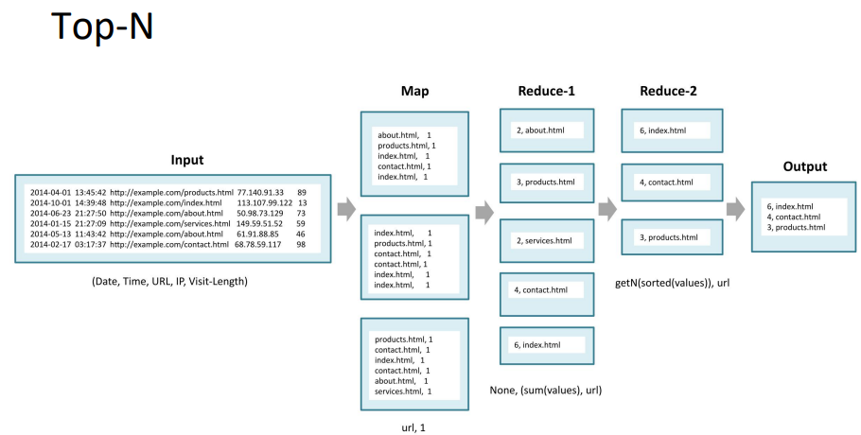

Slide 6
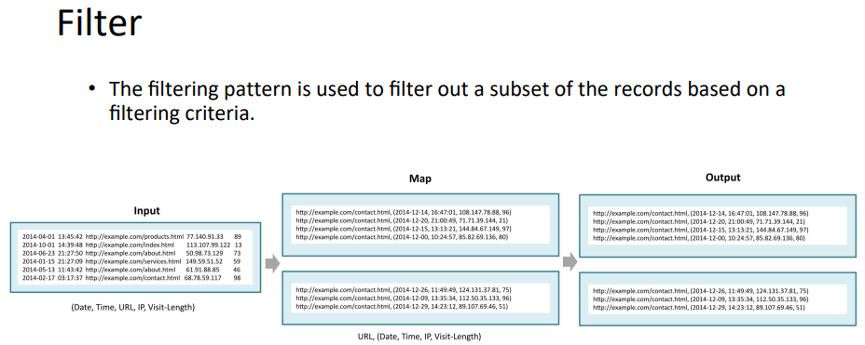

Slide 7
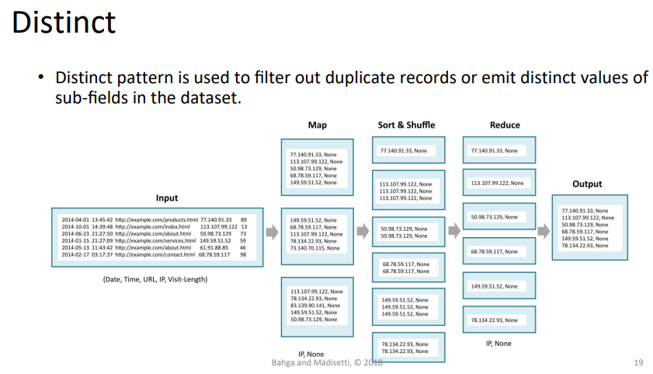

Slide 8
Jupyter – RegEX LAB Review(1/2)

Slide 9
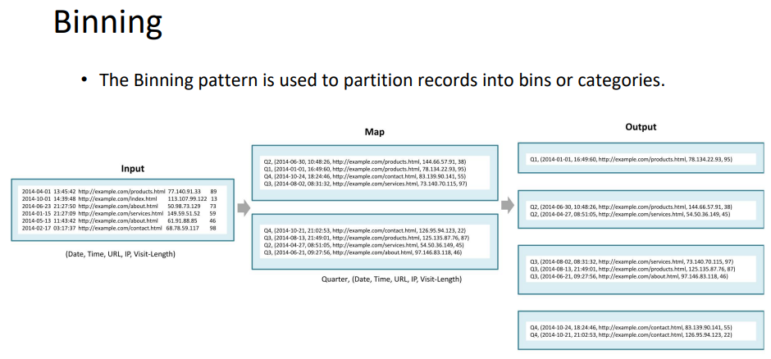

Slide 10
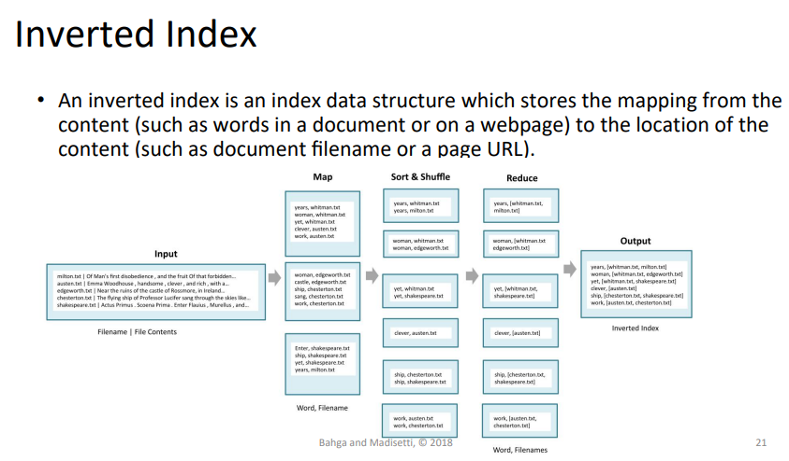

Slide 11
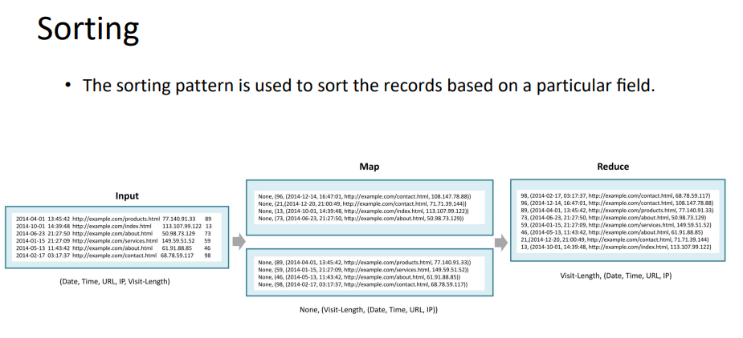

Slide 12
Relational Databases
A relational database is database that conforms to the relational model that was popularized by Edgar Codd in 1970.
The 12 rules that Codd introduced for relational databases include:
Information rule
Guaranteed access rule
Systematic treatment of null values
Dynamic online catalog based on relational model
Comprehensive sub-language rule
View updating rule
High level insert, update, delete
Physical data independence
Logical data independence
Integrity independence
Distribution independence
Non-subversion rule

Slide 13
Relational Databases
Relations
A relational database has a collection of relations (or tables). A relation is a set of tuples (or rows).
Schema
Each relation has a fixed schema that defines the set of attributes (or columns in a table) and the constraints on the attributes.
Tuples
Each tuple in a relation has the same attributes (columns). The tuples in a relation can have any order and the relation is not sensitive to the ordering of the tuples.
Attributes
Each attribute has a domain, which is the set of possible values for the attribute.
Insert/Update/Delete
Relations can be modified using insert, update and delete operations. Every relation has a primary key that uniquely identifies each tuple in the relation.
Primary Key
An attribute can be made a primary key if it does not have repeated values in different tuples.

Slide 14
OLTP vs OLAP
Relational databases can be characterized into two categories:
Online Transaction Processing (OLTP)
Online Analytical Processing (OLAP)
OLTP involves several short online transactions. OLTP systems are suitable for transaction-oriented applications such as an eCommerce application which require frequently writing new data, updating or deleting existing data, while maintaining the integrity of the data.
OLAP systems are referred to as data warehouses, which allow the analysis of data for making business decisions. OLAP systems have a lower volume of transactions as compared to OLTP systems; however, the queries are more complex.

Slide 15
MySQL
MySQL is an open source Relational Database Management System (RDBMS).
MySQL is one of the most widely used RDBMS and a good choice to be a serving database for data analytics applications where the data is structured.

Slide 16
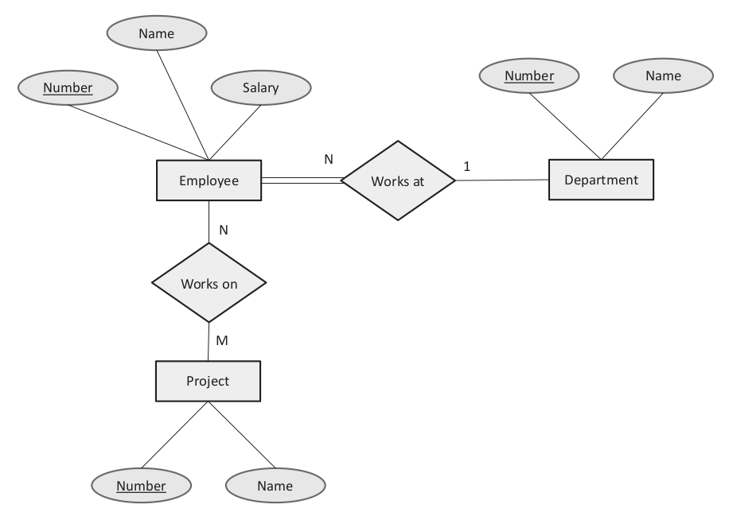
Entity-RELATIONSHIP MODELRelationship (ER) Diagram
Figure shows the Entity-relationship (ER) diagram for the reference application, which graphically represents the entities and their relationships to each other.
The ER diagram shows three entities - Employee, Department, and Project.
A one-to-one relationship exists between Employee and Department entities, whereas a many-to-many relationship exists between Employee and Project.

Slide 17
Mapping ER Model to Relational Model
To map the ER model represented in the ER diagram to a relational model, we follow the following rules:
For each regular entity in the ER model, create a relation (table).
Make the attributes of the entity as the attributes of the table (or columns in a table). Choose one of the key attributes of the entity as the primary key for the relation.
For 1:1 relationship between two entities (say P and Q), include as a foreign key in one of the relations, say the relation for entity P, the primary key of the other relation Q.
For 1:N relationship between two entities (say R and S), include as a foreign key in relation for entity S (where S is the entity on the N side of the relationship), the primary key of relation for entity R.
For a M:N relationship between two entities (say U and V), create a new relation and in that relation include as foreign keys, the primary keys of the relations for entities U and V. If the M:N relationship has any simple attributes, include those as well in the new relation.

Slide 18
SQL statements for creating tables
CREATE TABLE department(
number varchar(50) NOT NULL PRIMARY KEY,
name varchar(200) NULL
);
CREATE TABLE employee (
number varchar(100) NOT NULL PRIMARY KEY,
name varchar(100) NOT NULL,
salary varchar(20) NOT NULL,
department_id varchar(20) REFERENCES department (number),
);
CREATE TABLE project (
number varchar(20) NOT NULL PRIMARY KEY,
name varchar(100) NOT NULL
);
CREATE TABLE workson (
id INT(6) UNSIGNED AUTO_INCREMENT PRIMARY KEY,
employee_id varchar(20) NOT NULL REFERENCES employee (number),
project_id varchar(20) NOT NULL REFERENCES project (number)
);

Slide 19
SQL statements for inserting data into tables
INSERT INTO department VALUES ("1001", "ECE");
INSERT INTO employee (number, name, salary,department_id) VALUES ("5001",
"Alex", "50000", "1001");
INSERT INTO project VALUES ("201", "Cloud");
INSERT INTO workson(employee_id,project_id) VALUES ("5001", "201");

Slide 20
SQL statements for querying tables
# Retrieve all employees
SELECT * FROM employee;
# Retrieve top 3 employees with highest salary
SELECT * FROM employee ORDER BY salary DESC LIMIT 3;
# Retrieve all employees in department ’ECE’
SELECT e.name, e.number, d.name FROM employee e, department d WHERE d.name=’ECE’ ;
# Count the number of employees working on ’IoT’ project
SELECT COUNT(*) FROM project p, workson w WHERE p.name=’IoT’ ;

Slide 21
Amazon Relational Database Service (RDS)
Amazon Relational Database Service (RDS) is a web service that makes it easy to set up, operate, and scale a relational database in the cloud.
The benefit of using a managed relational database service such as RDS over your own on-premises database server or a database server running on a cloud instance (such as MySQL database server on running on EC2), is that with a managed service, you do not need to worry about operating system installation and patches, software installation, database engine patches, server maintenance, scalability, and backups.
RDS service takes care of all these tasks while you can focus on your application development.
RDS supports various database engines, including Amazon Aurora, MySQL, MariaDB,PostgreSQL, Oracle, and Microsoft SQL Server.
RDS supports two licensing models: License Included and Bring Your Own License (BYOL).

Slide 22
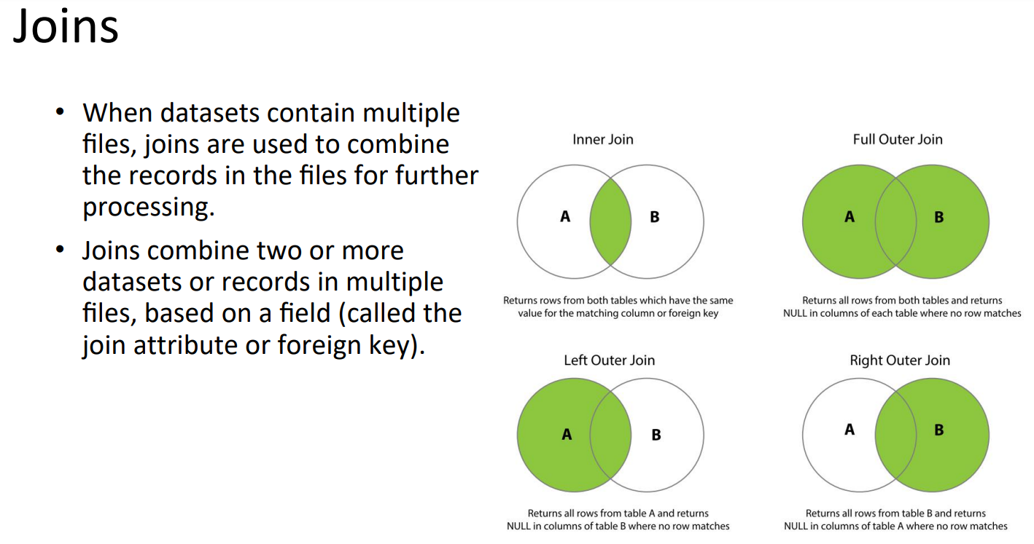

Slide 23
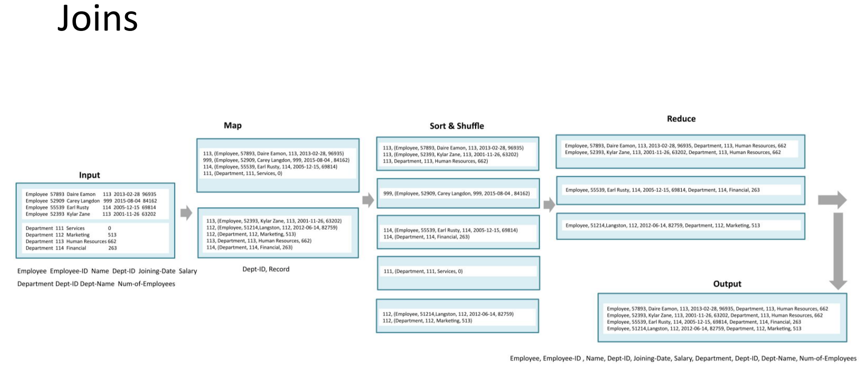

Slide 24
LAB2: map/reduce Log file – Questions?

